Slide 1
Final Project
Team 26
Man Wang 42054058
Yuxuan Tian 42054021

Slide 2
CONTENTS
Title
Dataset
Analysis
Data app demo

Slide 3

Title
The title is Students Performance in Exams
and we analysis the students performance in
math score、the relationship between reading score
and writing score.
We will answer three questions:
1: How did the students perform on the math test
2: What is the influence of different parental education
background on the scores of the math test
3: What is the relationship between the reading scores
and the writing scores of these students

Slide 4
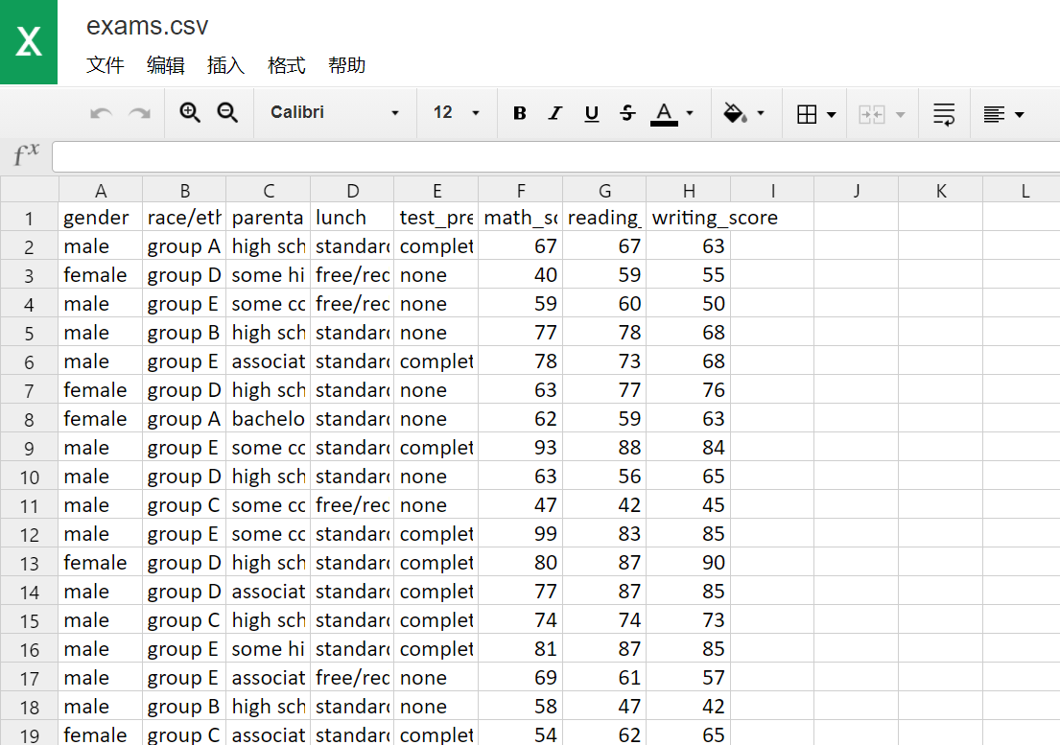
Dataset
We use the dataset called exams.csv which can be found in https://42054021.github.io/Final-Project/exams.csv

Slide 5
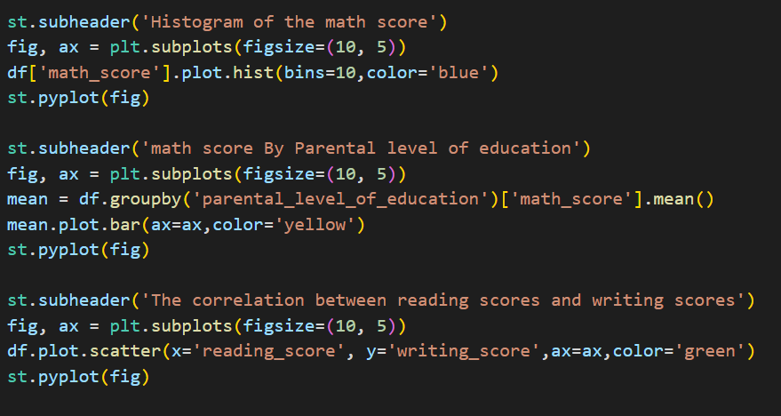
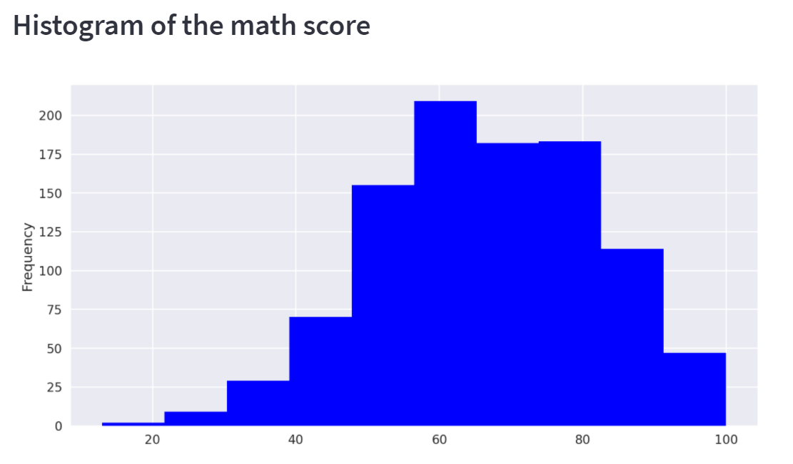
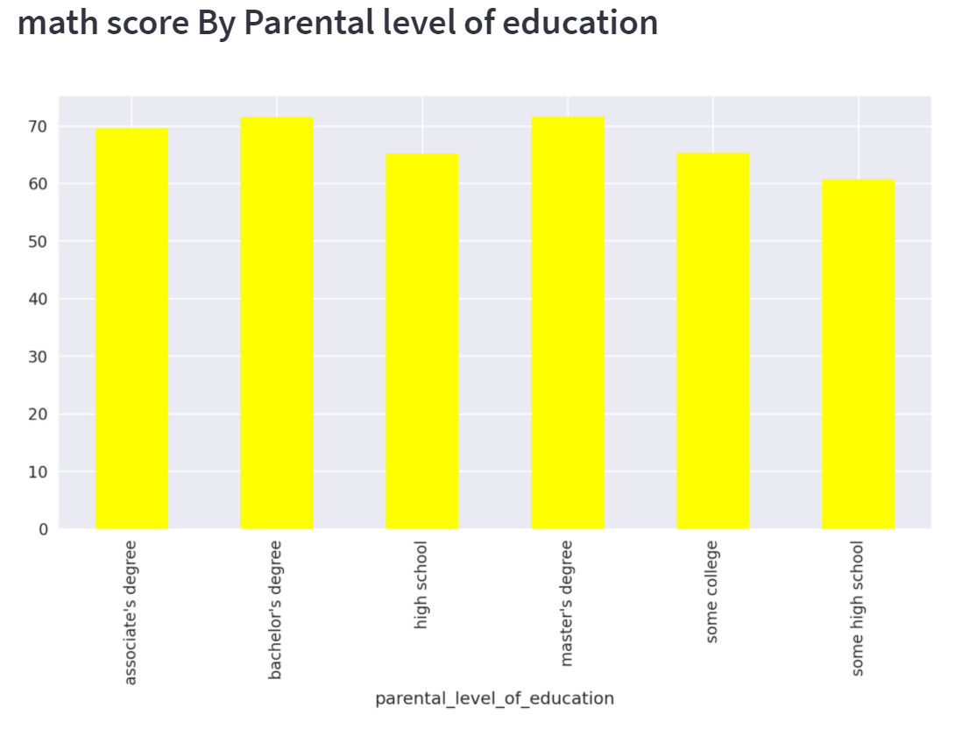
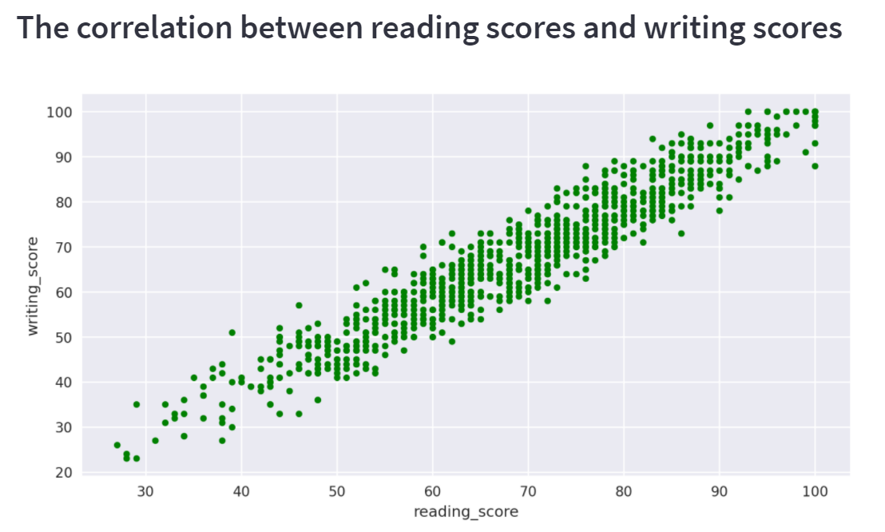
Analysis

Slide 6
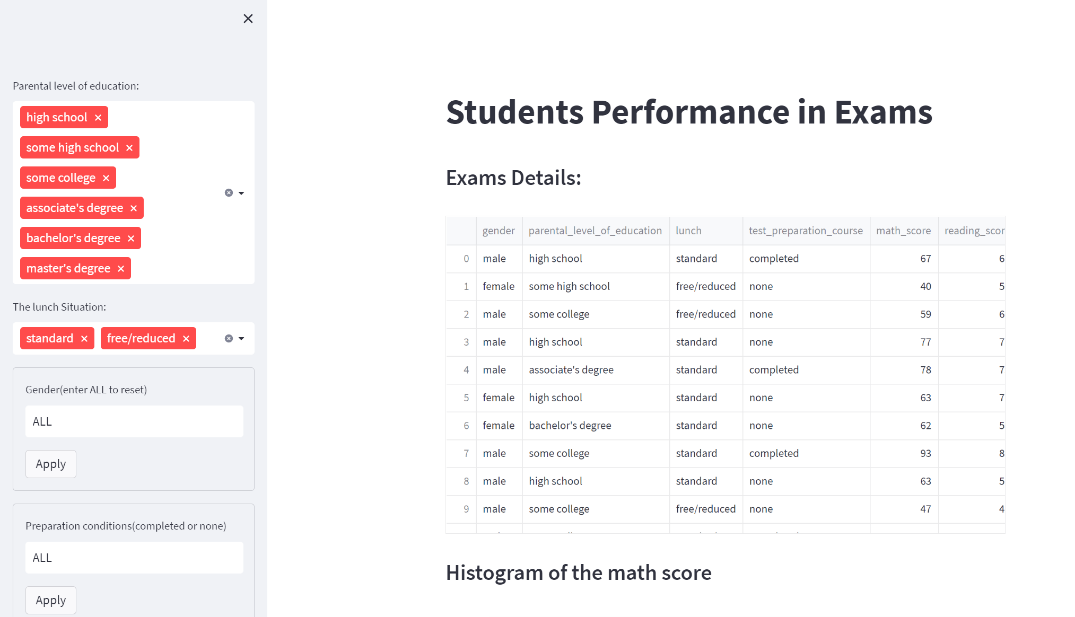
Data app demo

Slide 7
Thanks

